Slide 1


Web Services Using SOAP
BUILDING OWN WEB SERVICES

Slide 2


SOA
SOA (Service-Oriented Architecture) is an architectural style for building software applications that use services available in a network such as the web. It promotes loose coupling between software components so that they can be reused. Applications in SOA are built based on services. SOA is a standardized architecture which provides reliability, scalability and easy maintenance.
SOA consists of three basic components:
1. Service provider
2. Service broker
3. Service requestor

Slide 3
SOAP
SOAP (Simple Object Access Protocol) is an XML based protocol for accessing web services over HTTP/SMTP.
SOAP can extend HTTP for XML messaging.
SOAP provides data transport for Web services.
SOAP can exchange complete documents or call a remote procedure.
SOAP enables client applications to easily connect to remote services and invoke remote methods.
It is an application layer protocol.

Slide 4
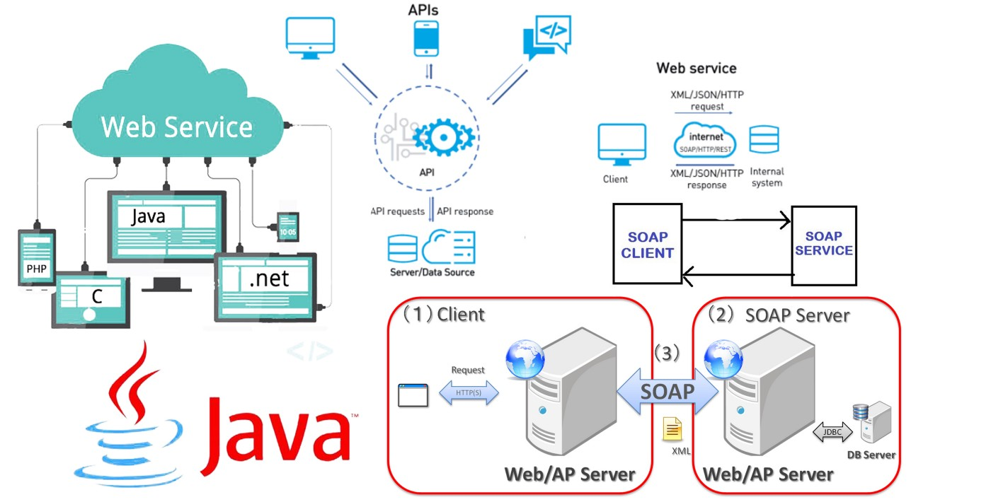
Generalized SOAP architecture for Web Services

Slide 5
Advantages of SOAP
Standardized protocol
It uses XML
Platform independent
It works on the HTTP/SMTP
Drawbacks of SOAP
Only supports XML
Slow because the payload is in XML
Not dynamic - whenever there is a change in the server-side, the client stub classes need to be generated again.

Slide 6
Implementation of SOAP
A SOAP Web Application has been implemented in Java. The application provides two services which are a basic calculator operation and IP address lookup for DNS domain names. Both services have been developed using the Bottom-up Java bean Web Service.
When creating a Web service using a bottom-up approach, first the java classes for the web service are written and then the WSDL (XML notation for describing a web service) file is created, and the web service is published.
SOAP Service Classes:
Lookup
DemoClass

Slide 7
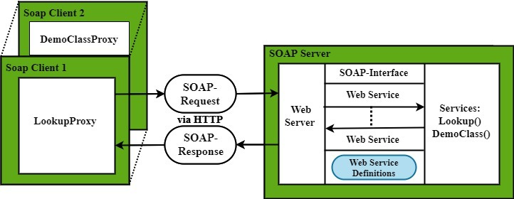
Architecture of the Implemented SOAP Web Services

Slide 8
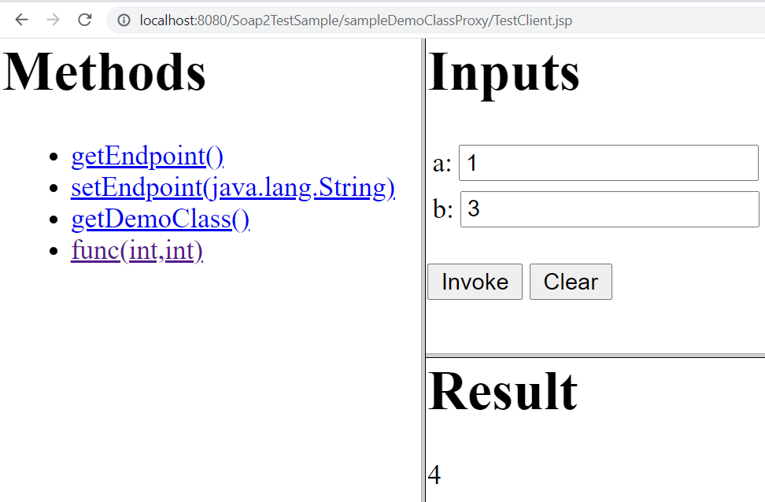
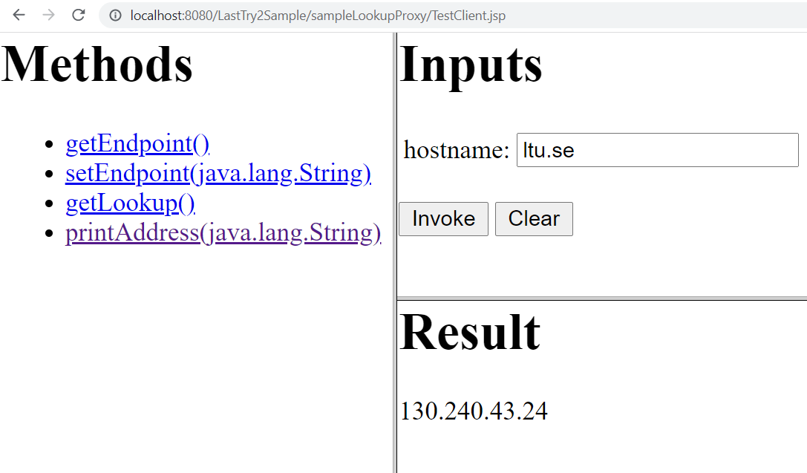
Demonstration of the Implemented Web Services

Slide 9
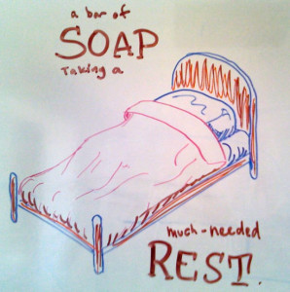
Conclusion
The main advantage of SOAP Web Services is that it provides a mechanism for services to describe themselves to clients, and to advertise their existence.
RESTful Web Service is much more lightweight and can be implemented using almost any tool, leading to lower bandwidth and shorter learning curve. However, the clients have to know what to send and what to expect.
In general, when publishing an API to the outside world that is either complex or likely to change, SOAP Web Services will be more useful. Other than that, RESTful is usually the better option.

Slide 10

References

